Slide 1
SoC Project

Slide 2
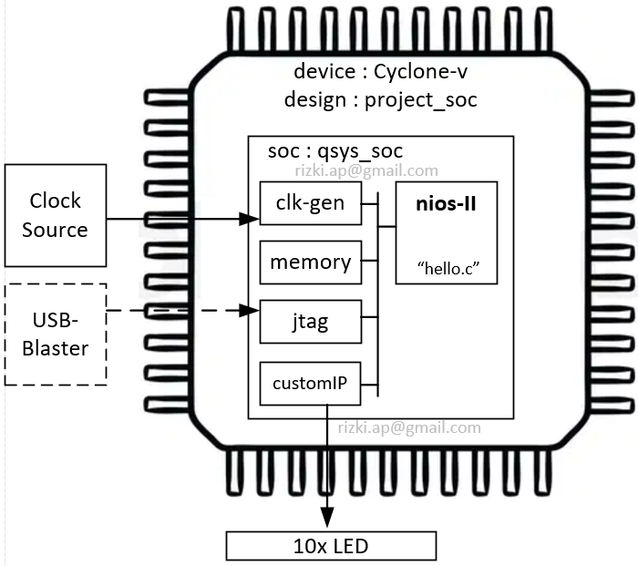
Creating Quartus Project
Project Directory : C:/Altera/project_soc
Project name :
project_soc

Slide 3
Add Verilog files
module CustomIP (
input [1:0] address,
input chipselect,
input clk,
input read,
input reset_n,
input write,
input [31:0] writedata,
output [9:0] led_out,
output reg [31:0] readdata
);
reg [9:0] DATA;
always @ ( posedge clk or negedge reset_n ) begin
if ( reset_n == 1'b0 ) begin
DATA <= 10'b0;
readdata <= 32'b0;
end else if ( chipselect && write && (address == 2'b0)) begin
DATA <= writedata[9:0];
readdata <= 32'b0;
end else if ( chipselect && read && (address == 2'b0) ) begin
readdata <= DATA;
DATA <= DATA;
end else begin
readdata <= 32'b0;
DATA <= DATA;
end
end
assign led_out = DATA;
endmodule
Save As : CustomIP.v
Add files to project:
  Project → Add/remove files in project
  Add custumIP.v to project

Slide 4
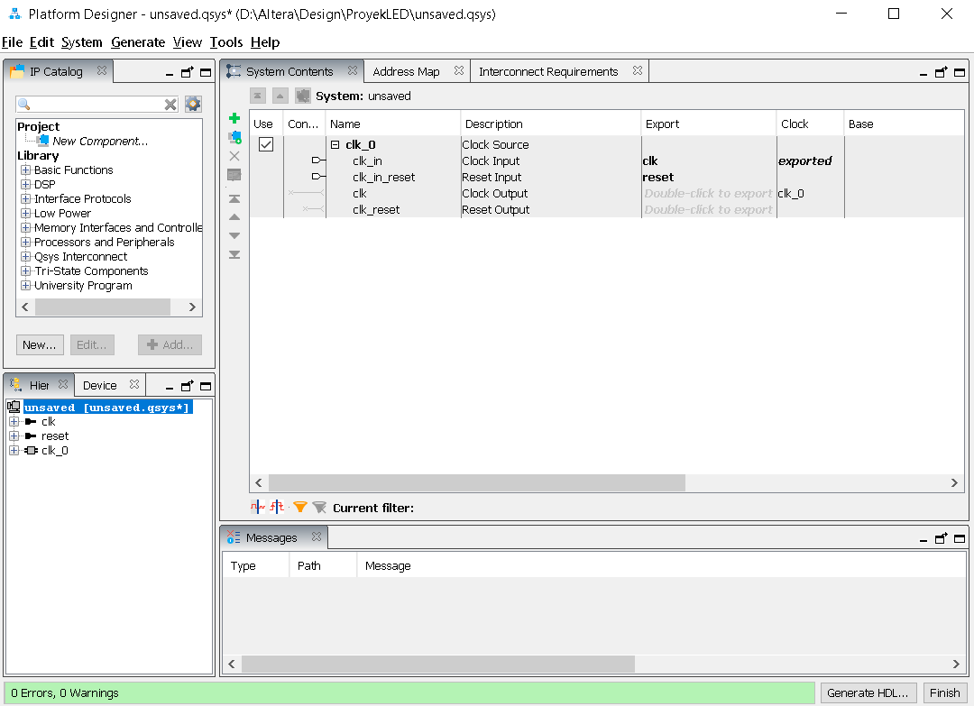
In Main Quartus windows :
Tools → Platform Designer

Slide 5
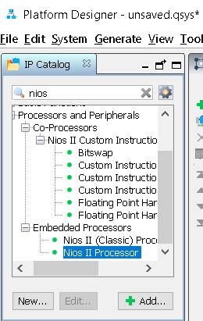
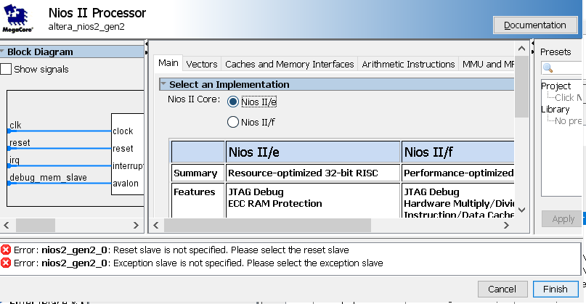
Adding Nios-II processor
  Find ‘nios’ in search box then choose Nios II Processor → click Add...
  then choose Nios-II/e → click Finish

Slide 6
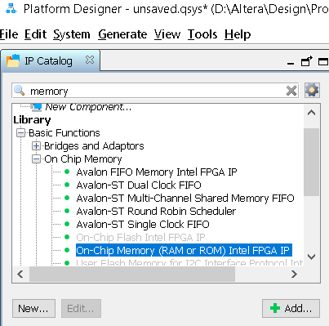
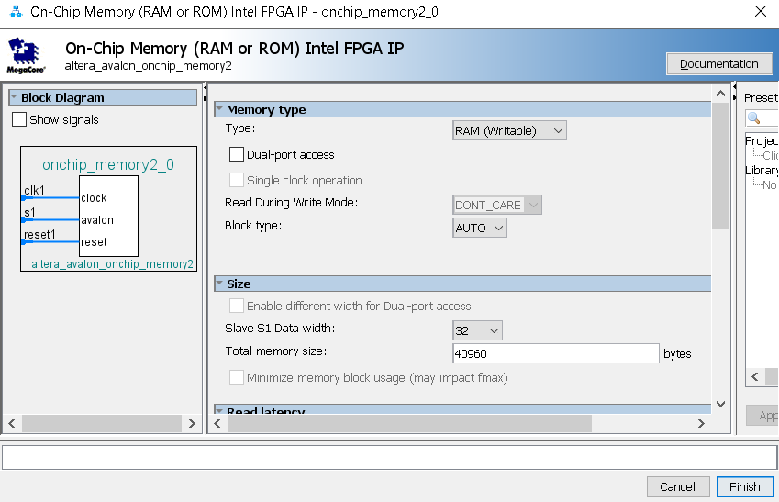
Adding Memory
  Find ‘memory’ in search box and choose On-Chip Memory (..) Intel FPGA IP → click Add...
  Then in field “Total memory size :” fill 40960 (bytes) → click Finish

Slide 7
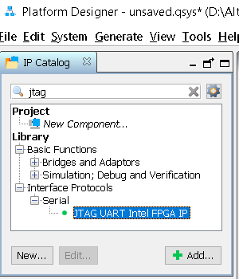
Adding JTAG
Find ‘jtag in search box and choose JTAG UART Intel FPGA IP → click Add... → click Finish

Slide 8
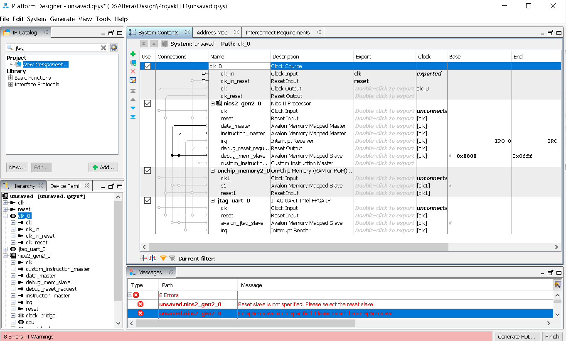
Checkpoint-1
If all steps succeeded, it will looks like :

Slide 9
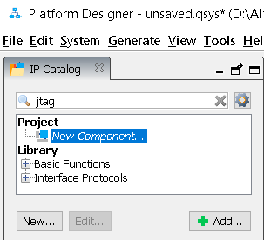
Adding Custom IP
In IP catalog menu, click New Component → Add..

Slide 10
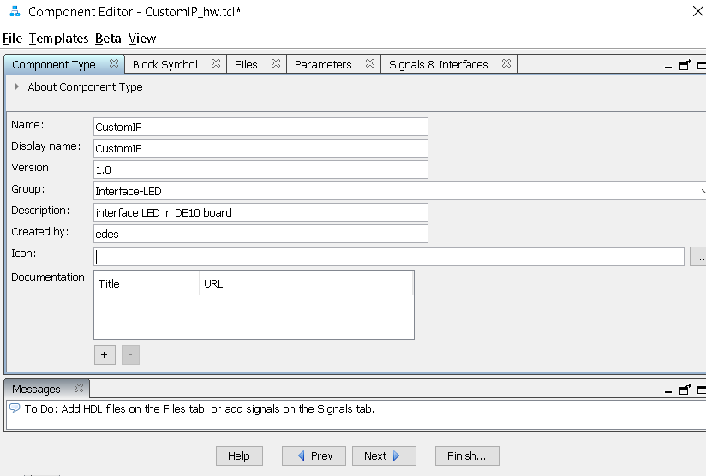
on “Component Type” tab, fill :
Name : CustomIP
Display name : Custom IP
Version : ...whatever...
Group : ...whatever...
Description : ... whatever...
Created by : ... whatever...
Icon : ... whatever...

Slide 11
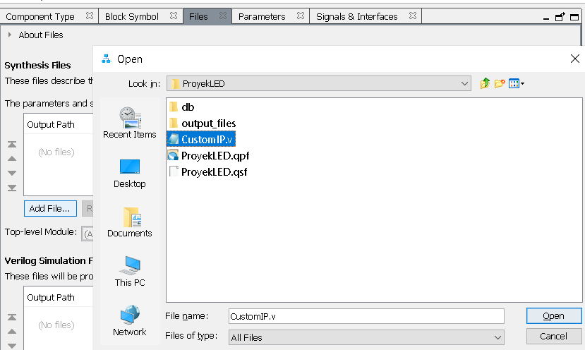
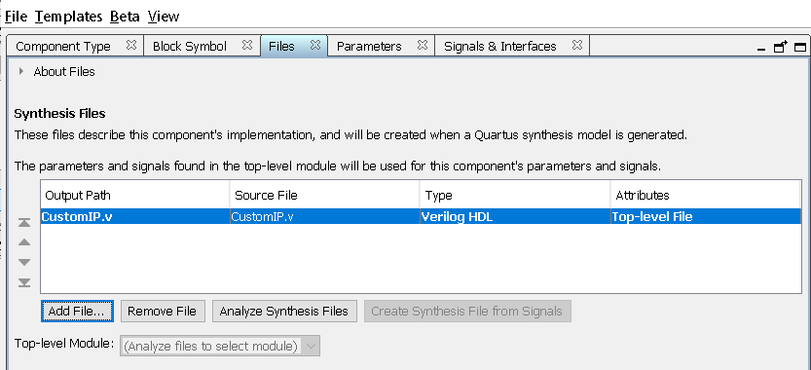
On the “Files” tab→ in section “Synthesis Files” → “add File...” point to file CustomIP.v → click Open.
After that, click “Analyze Synthesis File”

Slide 12
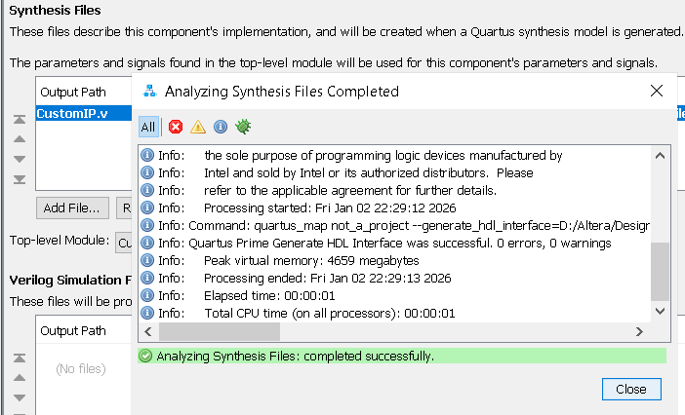
It should be success, if syntax is not error at all → CLOSE

Slide 13
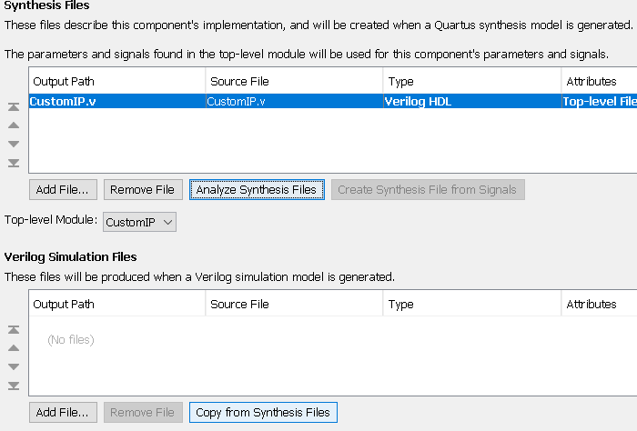
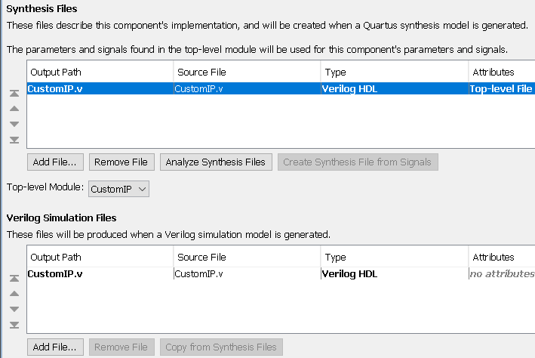
Underside, in field “Verilog Simulation Files”, click “Copy from Synthesis Files”

Slide 14
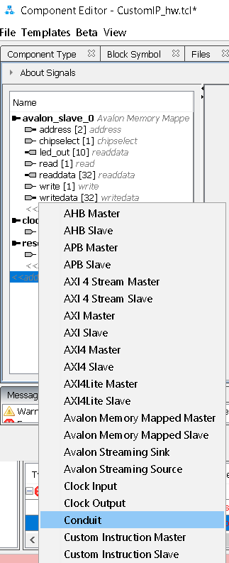
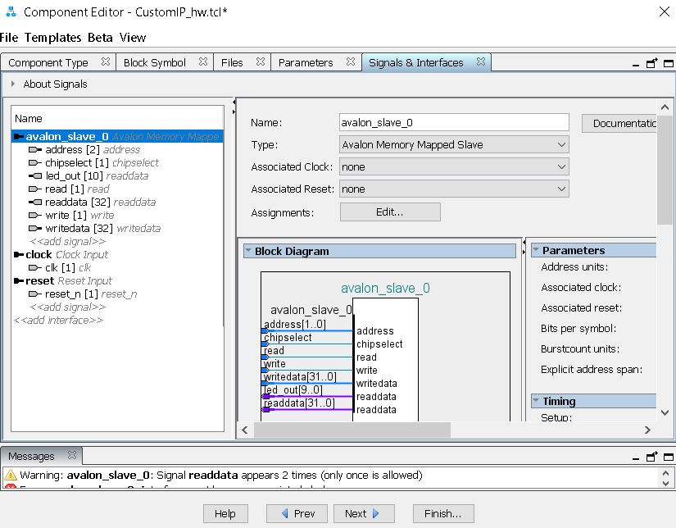
on “Signals & Interfaces” tab, click in “<<add interface>>” choose “Conduit”

Slide 15
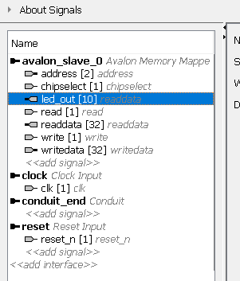
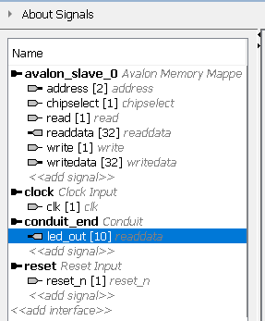
Choose signal “led_out[10] readdata”
drag-drop to under conduit →

Slide 16
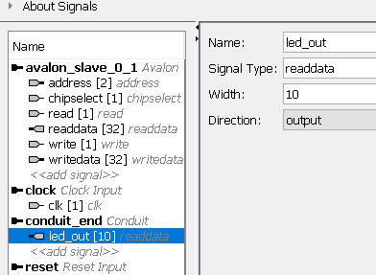
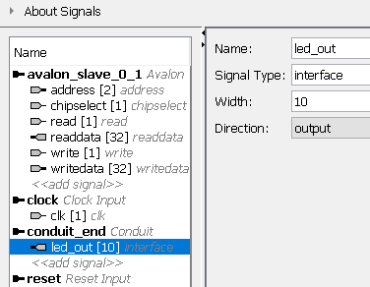
Change signal type “led_out[10]” from readdata to interface (whatever)
Change to →

Slide 17
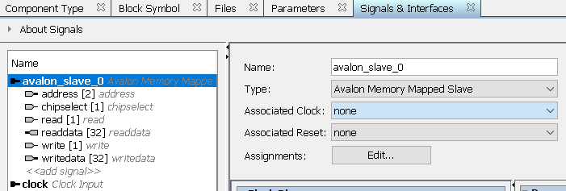
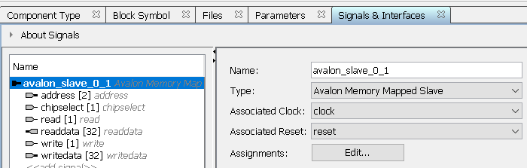
Click on “avalon_slave_0”
Ubah bagian “Associated Clock” → clock ; bagian “Associated Reset” → reset
Click Finish → Yes, Save

Slide 18
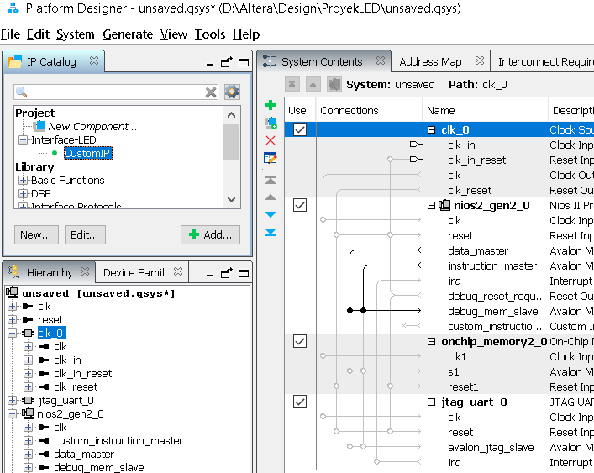
Back to Platform Designer
In IP Catalog menu, our CustomIP already there
Click in CustomIP → add
Click finish

Slide 19
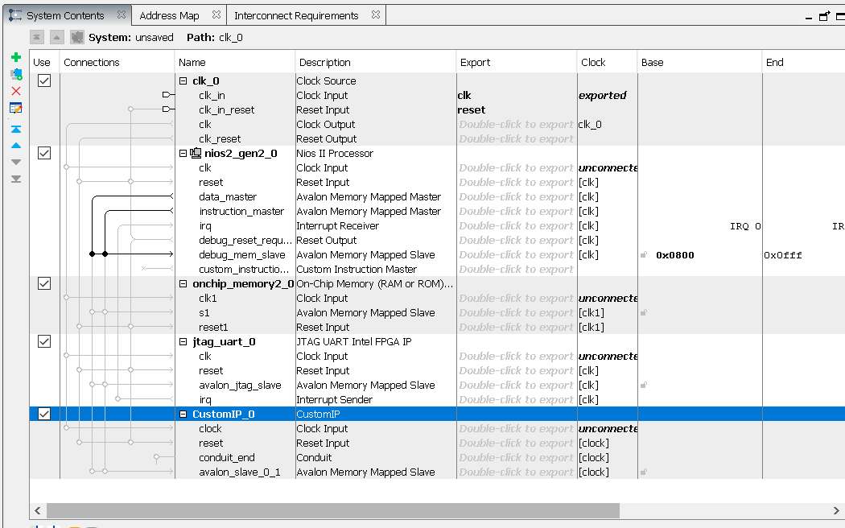
All System in our SoC to be Integrated

Slide 20
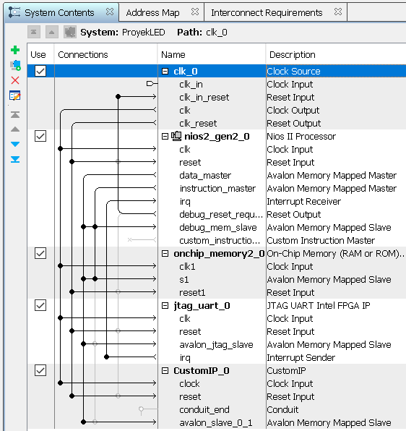
Click on Connection section,
So that connection is like this figure

Slide 21
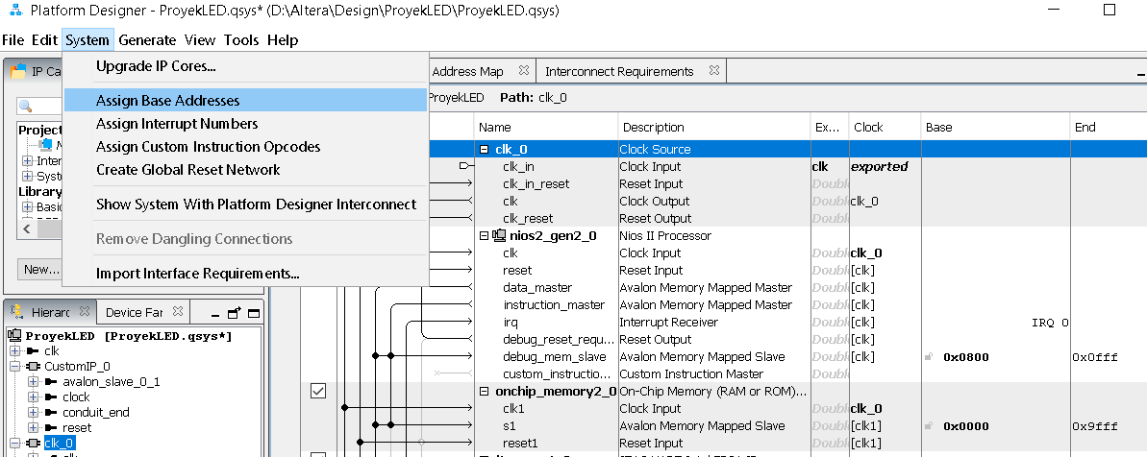
Assigning Base Address
Click on System → Assign Base Address

Slide 22
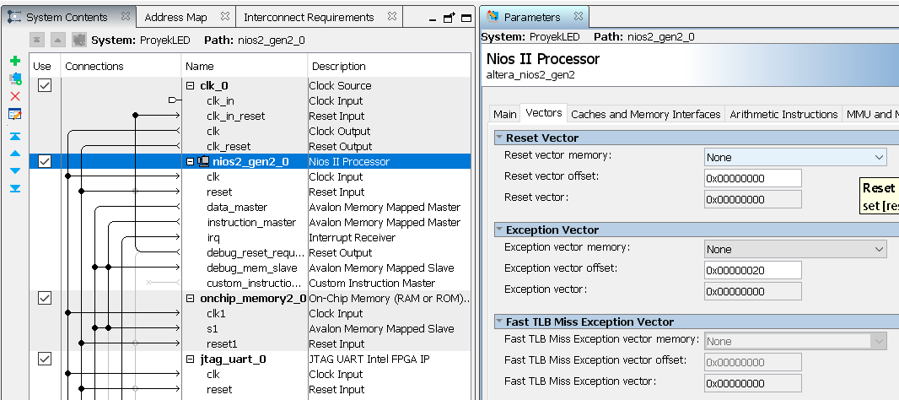
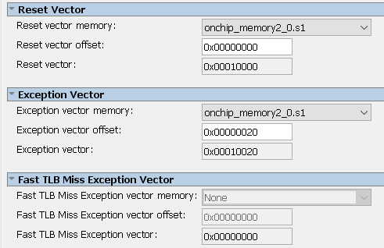
Assign Processor Vectors
Click on “nios2_gen2_0” → Parameter window appear → click tab/menu ” Vectors“:
In section “Reset vector memory :” choose “onchip_memory2_0.s1”
In section “Exeption vector memory :” choose “onchip_memory2_0.s1”
close Parameter window

Slide 23
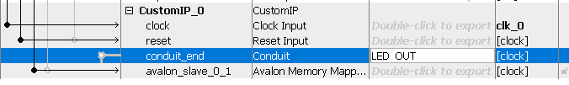
Change Conduit name
Double-click in CustomIP_0, rightside of “Conduit” change to “LED_OUT” → enter

Slide 24
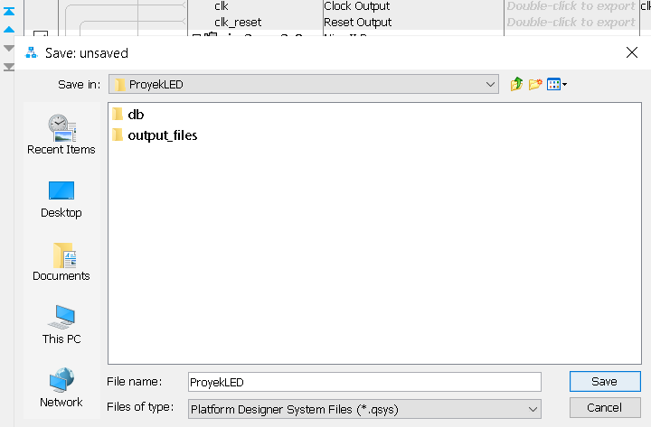
Save SoC Design
Save this QSYS design as project_soc
(must be same as the quartus project name)

Slide 25
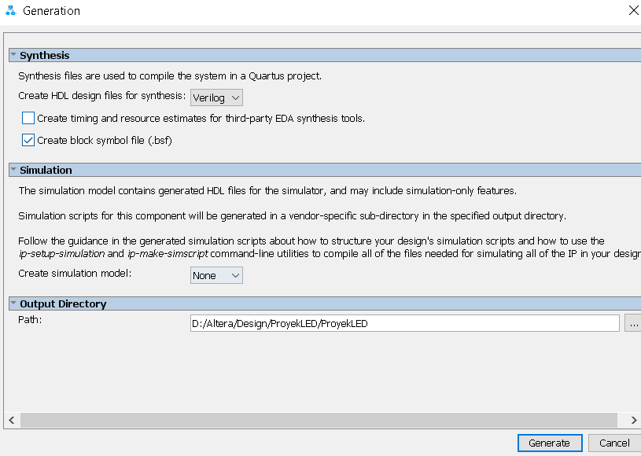
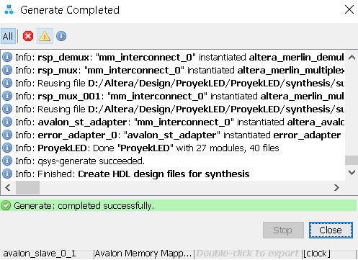
Generate file HDL
Generate >> Generate HDL... → Generate → Close

Slide 26
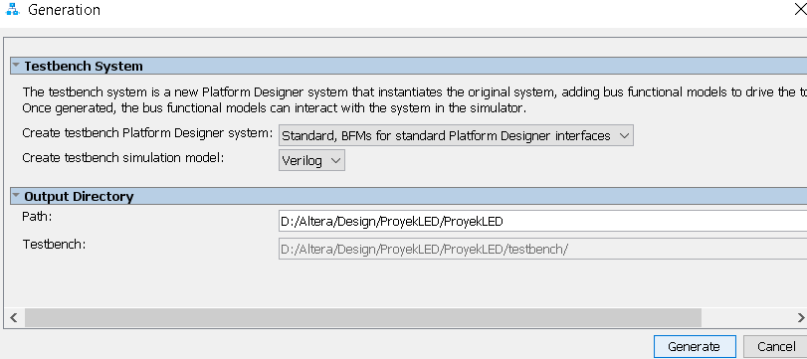
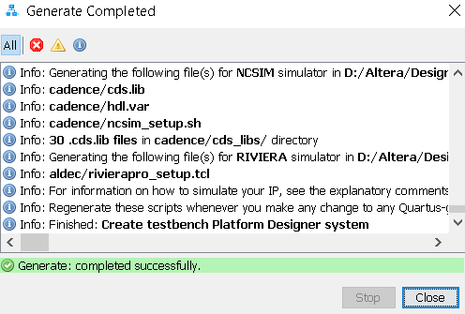
Generate Testbench
Generate >> Generate Testbench System... → Generate → Close

Slide 27
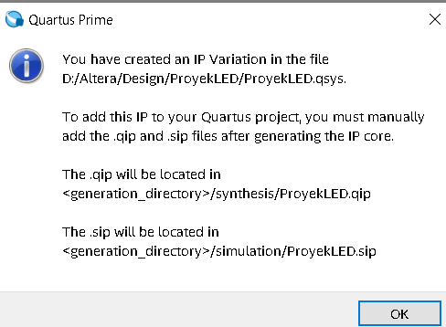
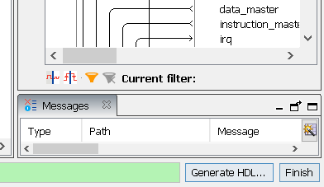
Closing Platform Designer
Close Platform Designer with Clicking“Finish” di bottom-right corner of the window.
Will appear warning to include your *.qip file to quartus.project click OK

Slide 28
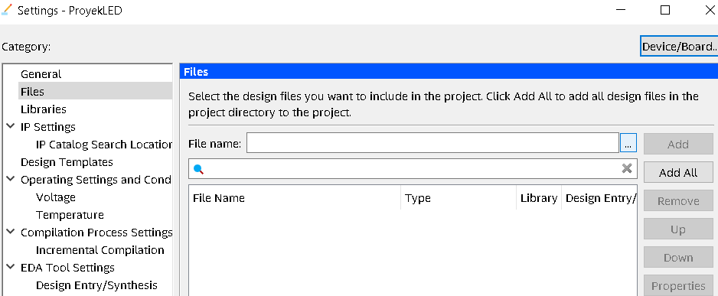
Add files to Quartus Project
In Quartus main window, Project >> Add/Remove Files in Project...
Klik bagian “...” di sebelah kanan “File name”, dan arahkan ke folder Proyek_soc/synthesis dan pilih file Proyek_soc.qip → open → OK

Slide 29
Analysis & Pin assignment
Do Analysis and Synthesis
Do Pin Planner :
  CLK pin
  10 led pin

Slide 30
Software Part

Slide 31
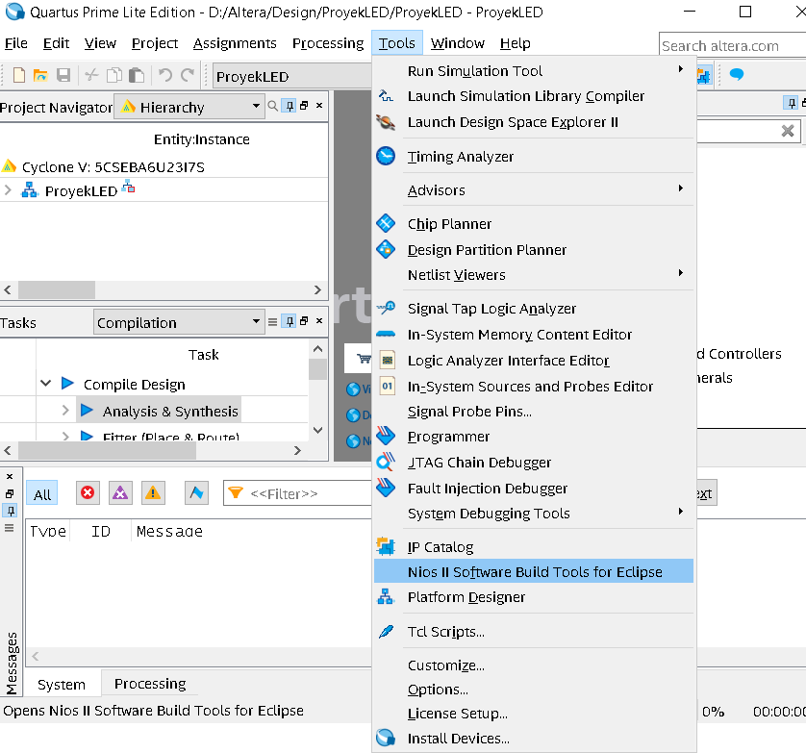
Nios-II Software IDE
Tools >> Nios II Software Build Tools for Eclipse

Slide 32
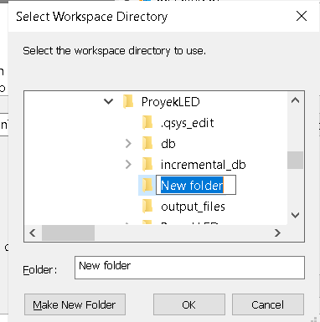
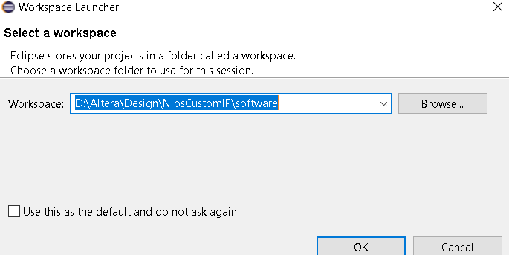

Workspace Launcher.
  Point to folder where your quartus project is, then create new folder named Software, then choose that Software folder → klik Ok .
  (for example full folder name is D:\Altera\Design\Proyek_soc\Software)

Slide 33
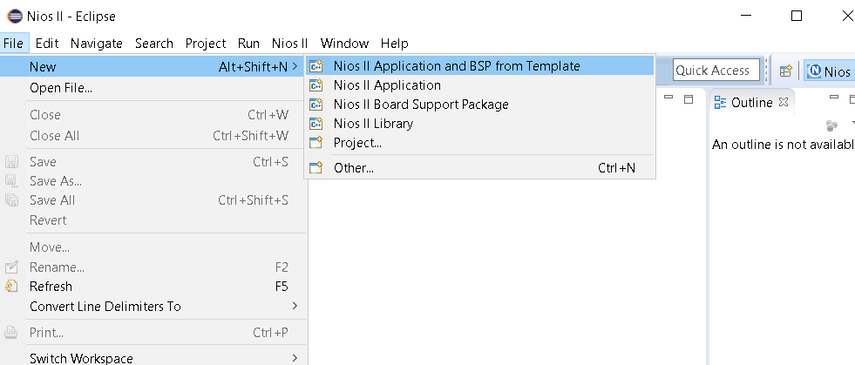
Then in Nios II – Eclipse windows, choose File >> New >> Nios II Application and BSP from Template

Slide 34
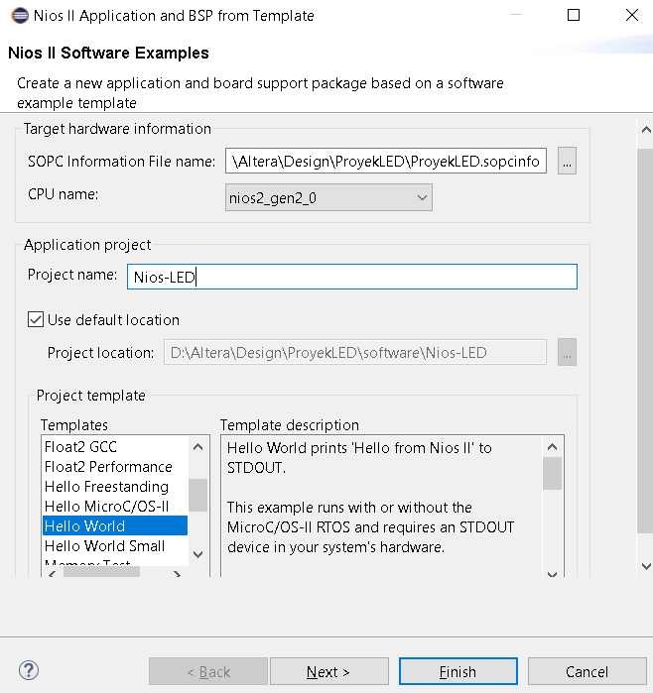
  In Next windows, choose/fill :
    SOPC Information File Name : D:\Altera\Desain\Project_soc\Project_soc.sopcinfo
    Project Name : Nios-LED (must different with project name)
    Project Template : Hello World or Hello World Small
    click Finish

Slide 35
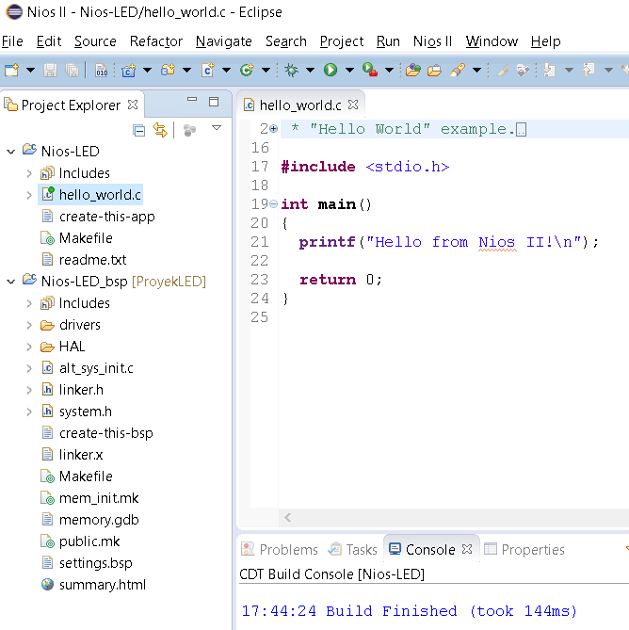
Buka file hello_world.c
Save, then Compile file program : Project >> Build All
#include "sys/alt_stdio.h"
#include "io.h"
#include "system.h"
int main()
{
printf ("Hello from Nios II!\n");
/* Event loop never exits. */
while (1){
IOWR(LEDS_0_BASE, 0, 0x155);
usleep(10000000);
IOWR(LEDS_0_BASE, 0, 0x2AA);
}
return 0;
}
Change to →

Slide 36
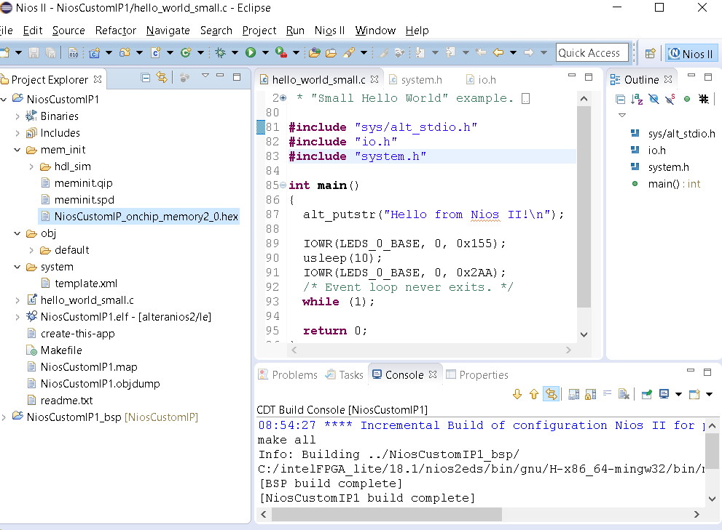
ELF file
If success, created :
*_onchip_memory*.hex
In mem_init folder

Slide 37
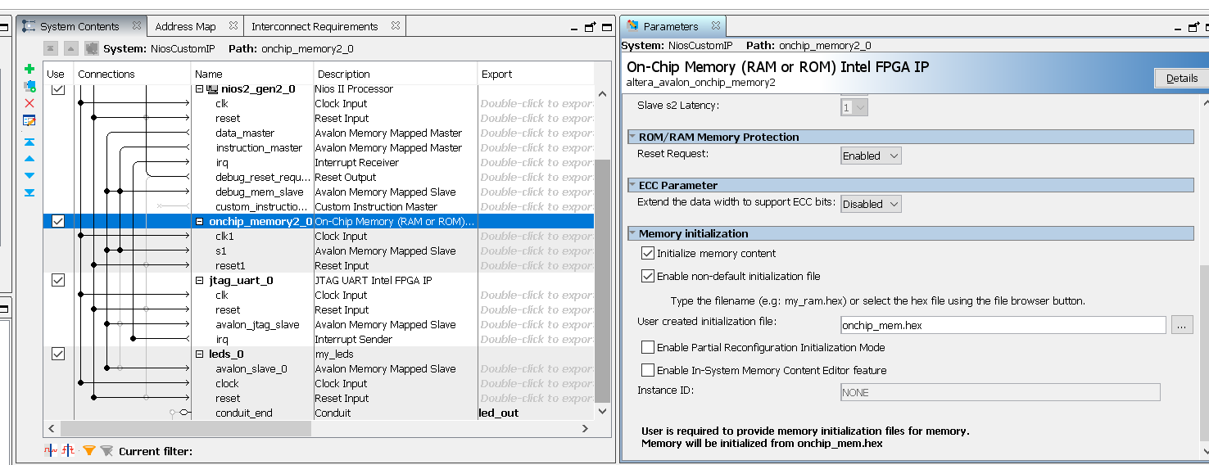
Return to Platform designer
Choose komponen onchip_memory*, double-click
Check the “Enable non-default initialization file”
On user created file : point to C:/altera/project_soc/software/mem_init/*onchip_memory*.hex

Slide 38
Compiling ALL
Re-generate the HDL File
Generate >> Generate HDL... → Generate → Close
Re-generate testbench
Generate >> Generate Testbench System... → Generate → Close
In quartus main windows, Processing → Start Compilation

Slide 39
Program the board
Program the board like previous project
See what happen to the board

